Slide 1

Knowledge 3

Slide 2
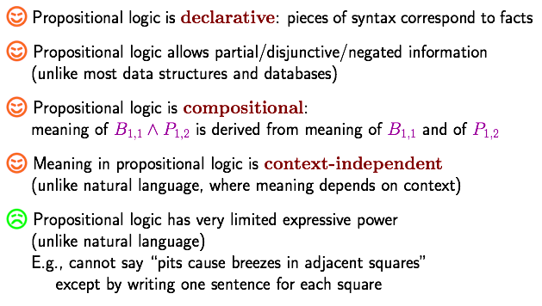
Pros and cons of propositional logic

Slide 3
First-order Logic: syntax and semantics

Slide 4
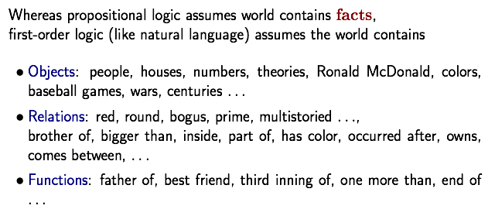
First-order logic

Slide 5
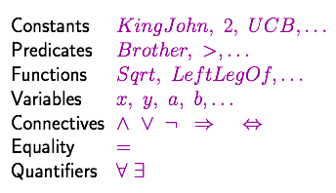
Syntax of FOL: Basic elements

Slide 6
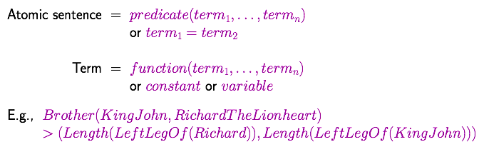
Atomic sentences

Slide 7
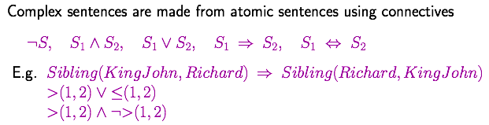
Complex sentences

Slide 8
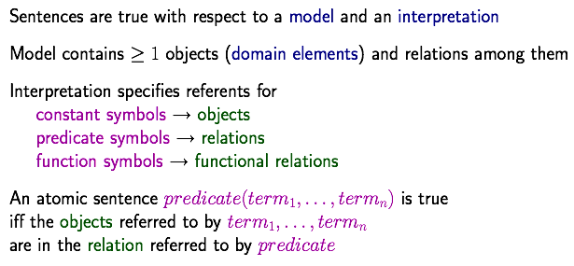
Truth in first-order logic
指示物

Slide 9
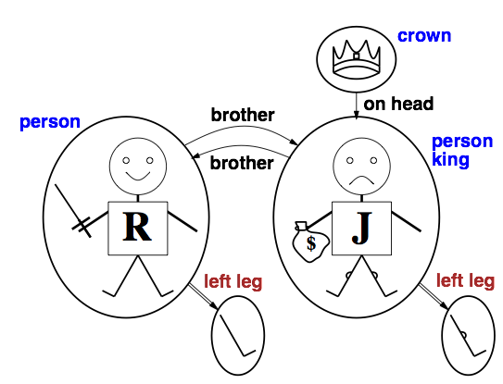
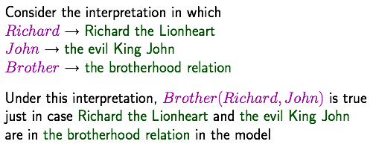
Models for FOL: Example

Slide 10
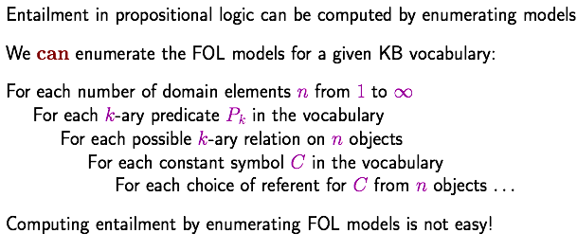
Models for FOL: Lots!

Slide 11
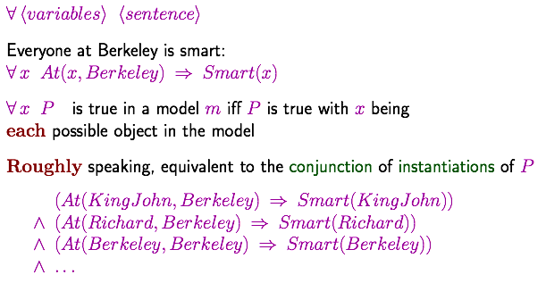
Universal quantification

Slide 12
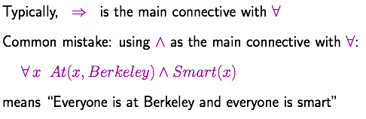
A common mistake to avoid

Slide 13
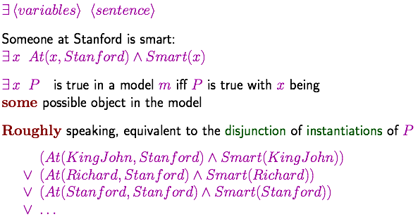
Existential quantification

Slide 14
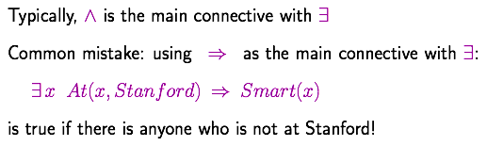
Another common mistake to avoid

Slide 15
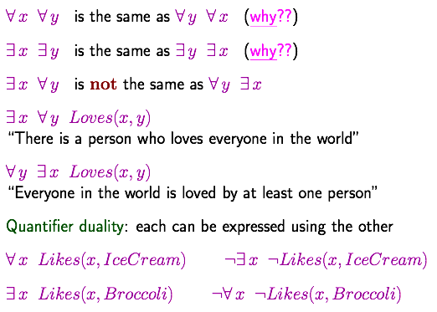
Properties of quantifiers

Slide 16
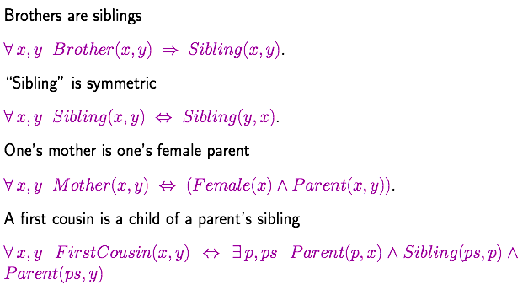
Fun with sentences
第一代的堂兄妹

Slide 17
Fun with sentences
不到长城非好汉。
到了长城就是好汉。

Slide 18
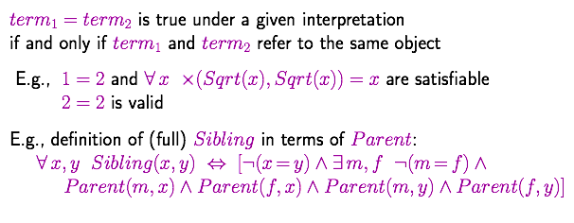
Equality

Slide 19
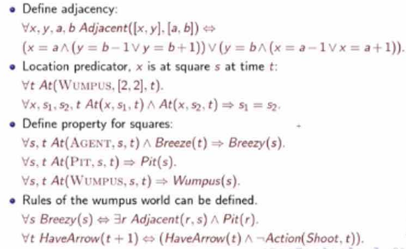
Back to the wumpus world again

Slide 20
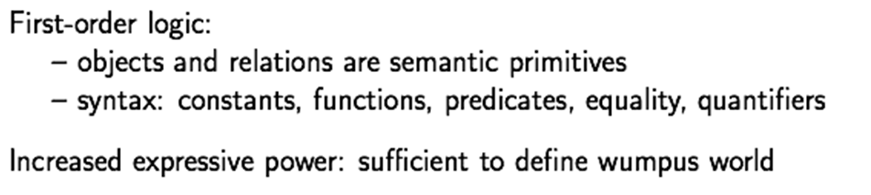
Short Summary

Slide 21
研究形式逻辑的目的是什么？
将一组知识形式化为符号
通过形式推演，自动推出结论
可靠
完备

Slide 22
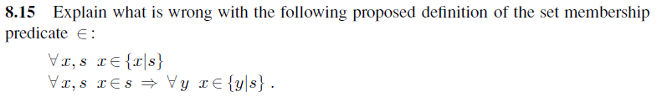
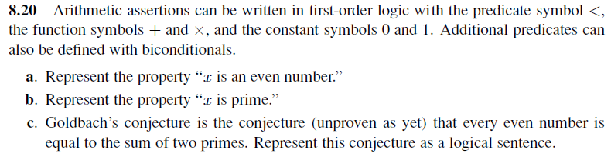
Homework

